Slide 1

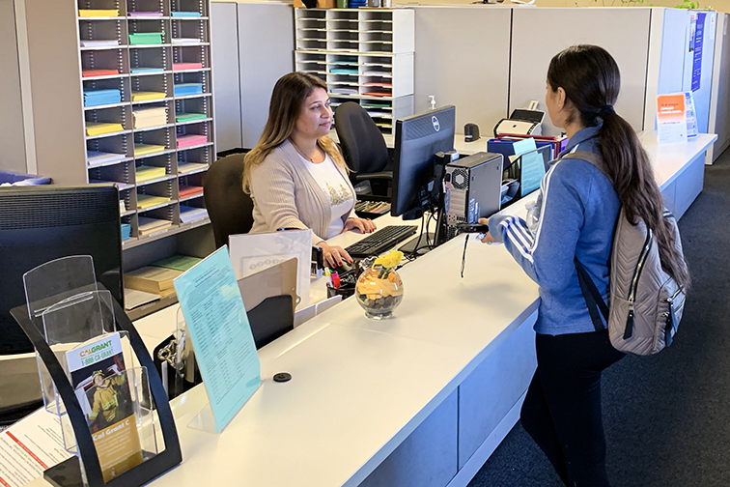






Title IX++ Updates
Josh Whitlock, Parker Poe Adams & Bernstein LLP
Tuesday, November 17, 2020
#N3CSDPA

Slide 2
Five Things to Know
Quick review of the basics (scope/obligations).
Seismic regulatory swings 2011 to present.
Massively impactful 2020 Final(ish) Rule (narrow scope, formalize procedures, re-balance equities).
More big regulatory changes just ahead.
And it’s not just about federal regulations (court decisions, industry standards and best practices, state and local laws).

Slide 3

The Title IX++ Bucket
Title IX prohibits discrimination on the basis of sex, which can include:
Rape →
Sexual violence →
Sexual assault →
Sexual/GB harassment →
Dating violence →
Domestic violence →
Stalking →
Sexual exploitation →
Sexual coercion →

Slide 4
Five Suggestions
Cross-departmental audit of current state of policies/procedures, training, etc.
Revisit the team (core and extended).
Regular mini-trainings/tabletop exercises.
Watch the space and maximize free resources (blogs, daily updates, webinars, etc.).
Revisit training in 2021 with focus on creativity, practicality, effectiveness, and bar raising.
#N3CSDPA

Slide 5

Questions and Discussion
Josh Whitlock
Partner
Parker Poe Adams & Bernstein LLP
joshwhitlock@parkerpoe.com
Office: 704.335.6622
Mobile: 704.614.6005
Thank you for joining us today!
#N3CSDPA

